Slide 1

Artificial Intelligence - Heuristic SEARCH

Slide 2
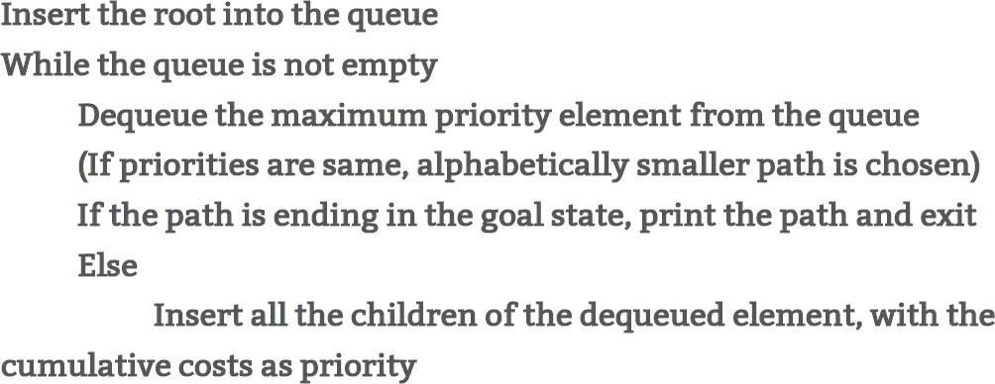
Uniform-cost search
Instead of expanding the shallowest node, uniform-cost search expands the node n with the lowest path cost g(n)
Expand least-cost unexpanded node-Cheapest-First Search
Implementation:
fringe = queue ordered by pathcost
Equivalent to breadth-first if path cost of all edges is same
the goal test is applied to a node when it is selected for expansion rather than when it is first generated

Slide 3
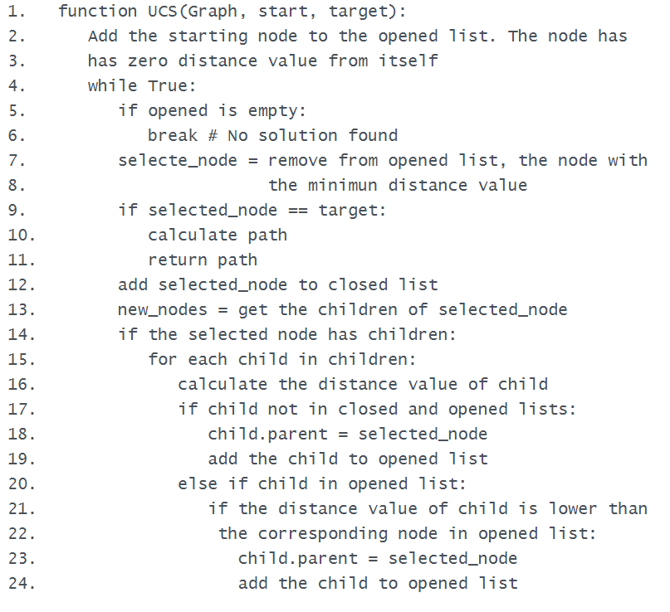

Slide 4
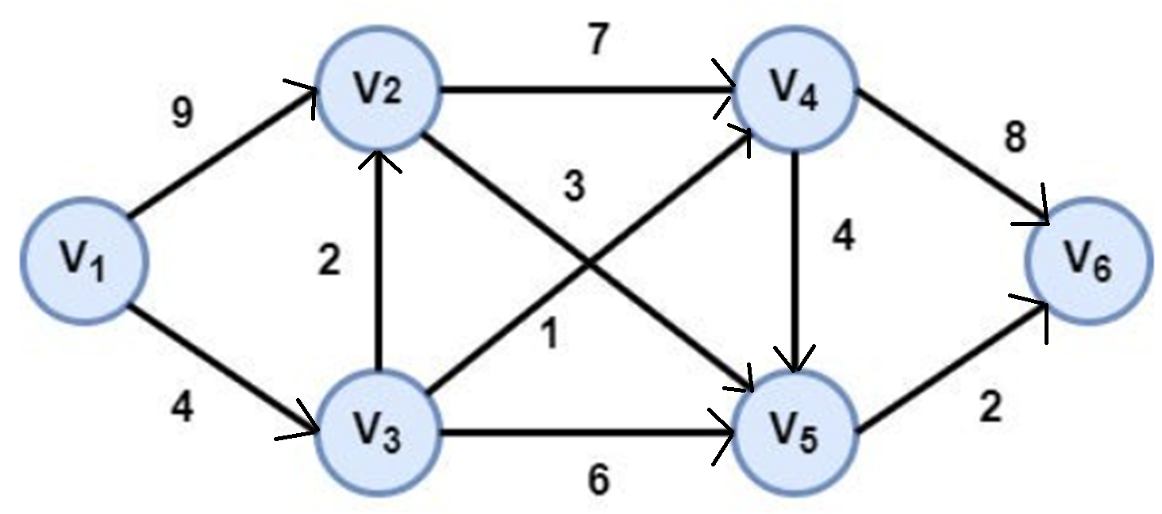
Example

Slide 5
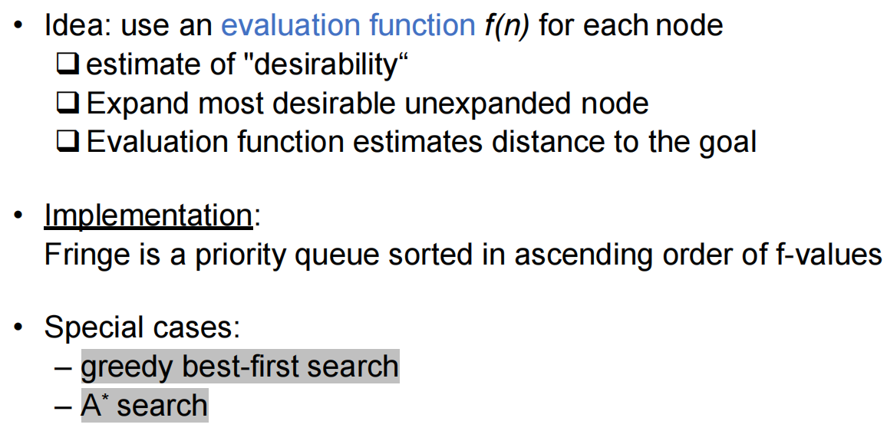
Best first search

Slide 6
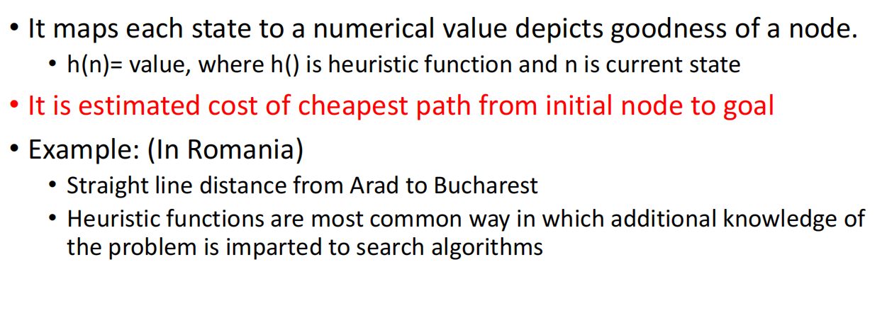
Heuristic function

Slide 7
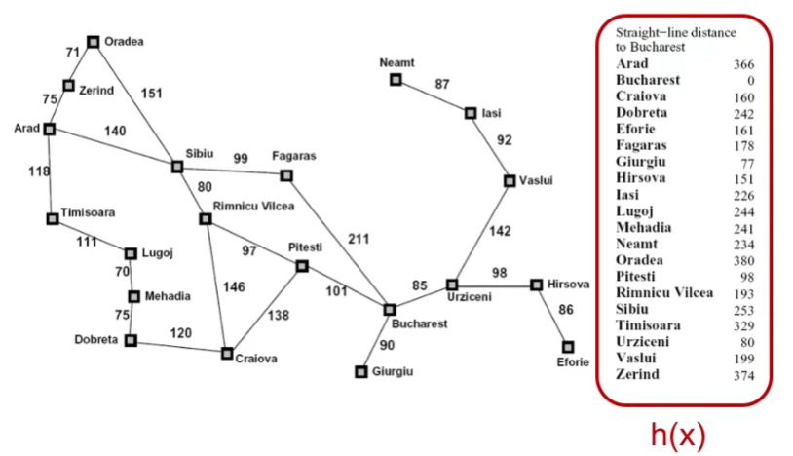
Romania with step costs in km

Slide 8
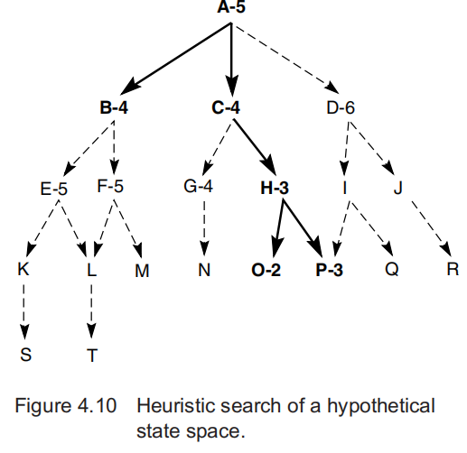
BEst first search
The states with attached evaluations are those actually generated in best_first_search.
The states expanded by the heuristic search algorithm are indicated in bold; note that it does not search all of the space.
The goal of best-first search is to find the goal state by looking at as few states as possible; the more informed the heuristic, the fewer states are processed in finding the goal.

Slide 9
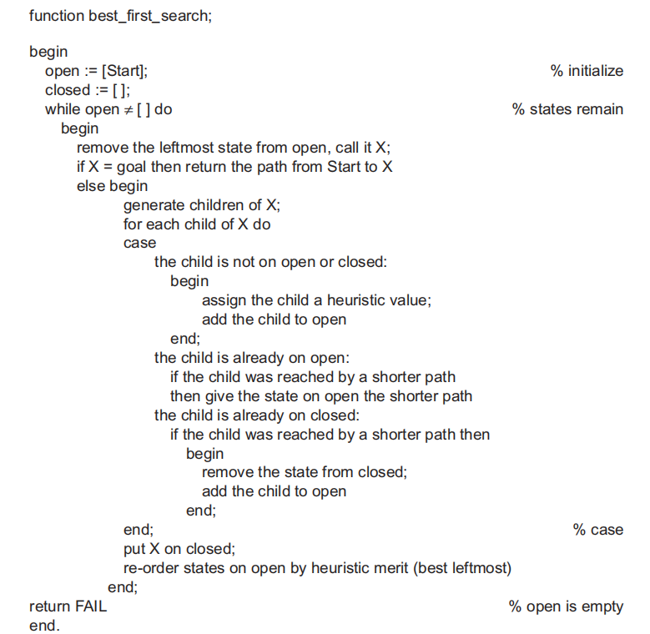

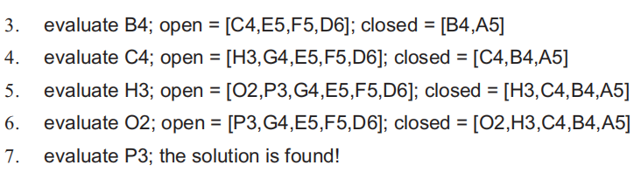

Slide 10
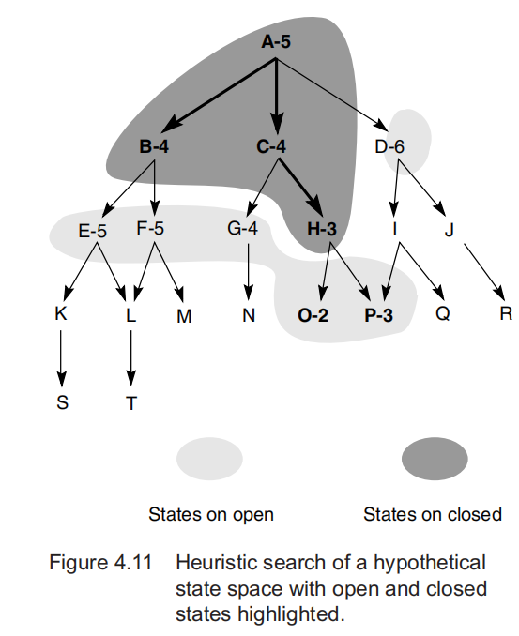

Slide 11
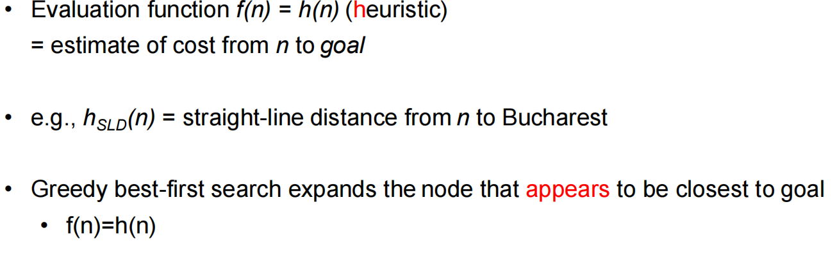
Greedy best-first search
Greedy best-first search tries to expand the node that is closest to the goal, on the grounds that this is likely to lead to a solution quickly.
It evaluates nodes by using just the heuristic function;

Slide 12
Romania with step costs in km

Slide 13

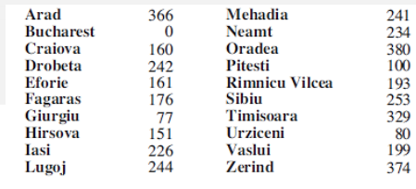
Greedy best-first search example

Slide 14
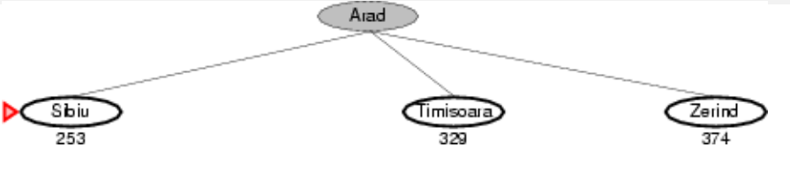

Slide 15
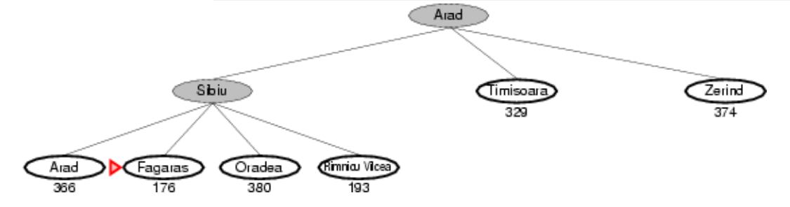

Slide 16
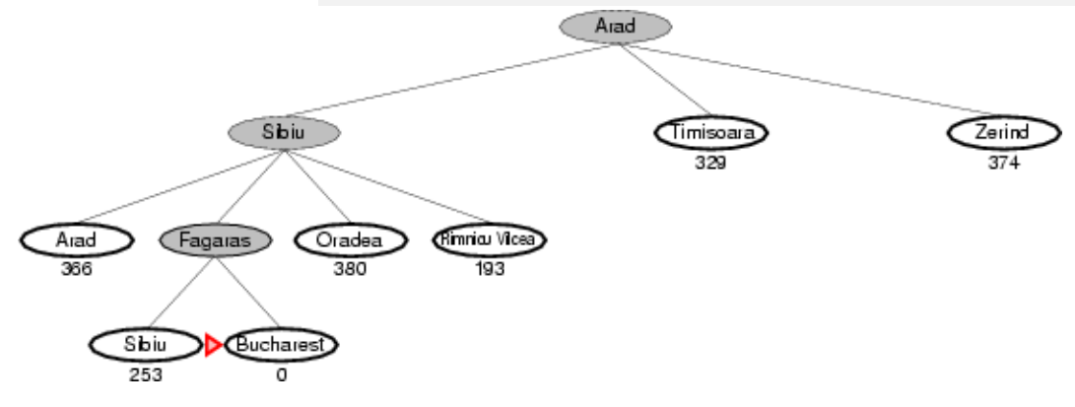

Slide 17
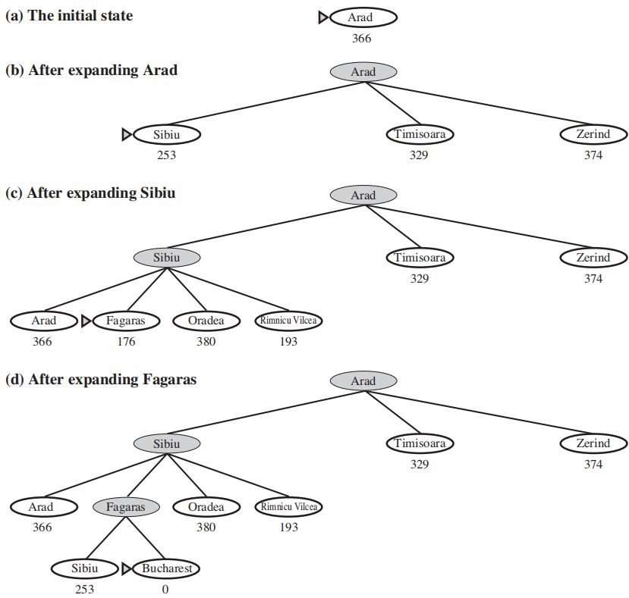

Slide 18
For this problem greedy best first search using SLD finds a solution without expanding a node that is not on the solution path. So search cost is minimal.
It is not optimal
Greedy best-first tree search is also incomplete even in a finite state space, much like depth-first search
Consider the problem of getting from Iasi to Fagaras. The heuristic suggests that Neamt be expanded first because it is closest to Fagaras, but it is a dead end.
The solution is to go first to Vaslui—a step that is actually farther from the goal according to the heuristic—and then to continue to Urziceni, Bucharest, and Fagaras.
The algorithm will never find this solution, however, because expanding Neamt puts Iasi back into the frontier, Iasi is closer to Fagaras than Vaslui is, and so Iasi will be expanded again, leading to an infinite loop.

Slide 19
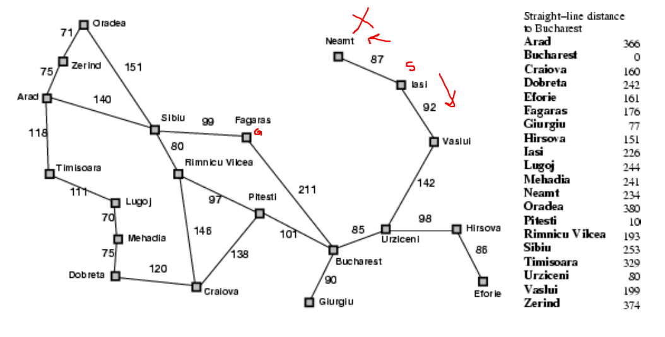

Slide 20
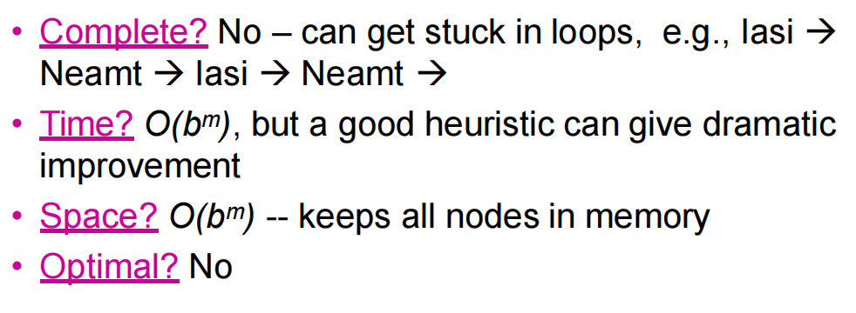
Properties of greedy best-first search

